Slide 1
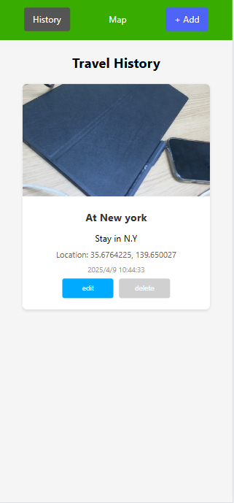
Web and Mobile Development
Demo presentation

Slide 2
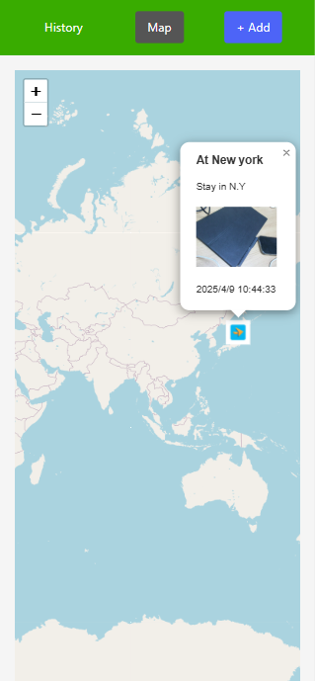

Travel Recorder
This is a PWA application
Can be installed easily installed on android and ios phones
Use to record your footprints.
Logo

Slide 3
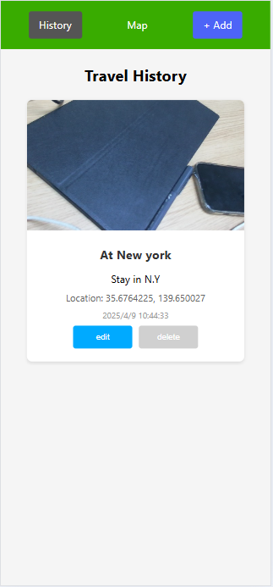
Why PWA?
It is designed to be fast and responsive
Installed directly from a website with a simple click
IDE:VScode
VS Code has a lightweight and user friendly interface. It offers a wide range of extensions that are very useful for React development
Install steps
Visit app’s website and click “install it to desktop” button of browser like chrome or safari
Why chose a travel app
It allowed me to incorporate various features like geolocation and camera for recording travel history which were great opportunities to practice CRUD operations and integrate device APIs.

Slide 4
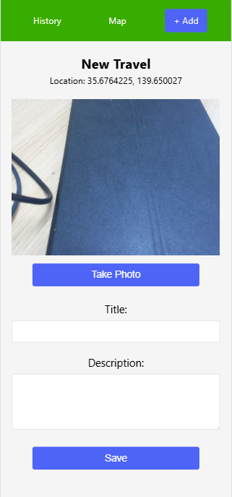
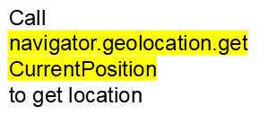
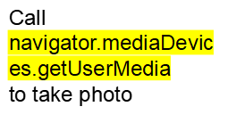
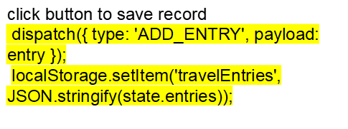
Add a travel record

Slide 5
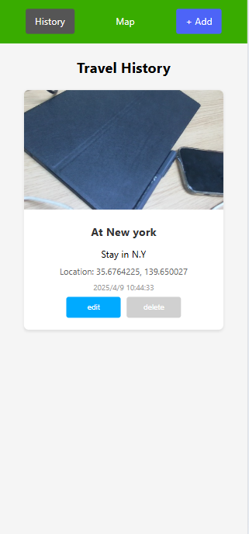
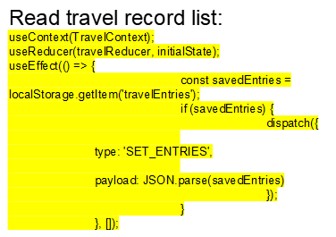


Read,Update,Delete record

Slide 6
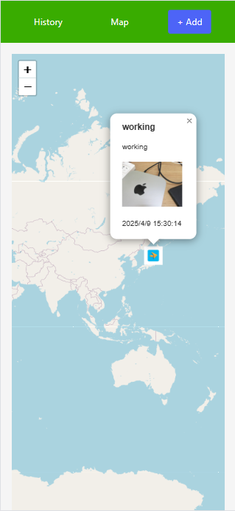
Enhancement
Map feature:
Use map to show travel footprints
MapContainer from library ‘react-leaflet’

Slide 7


React techniques used in app
useContext
useReducer
useEffect
useState

Slide 8
Potential improvement
The most improvement in my app is the UI,If there is a professional designer, he/she will make my app more aesthetically pleasing.
conclusions about using ReactJS
My experience with ReactJS for mobile development has been positive. The development speed is relatively fast due to the reusable components and the ability to use a single codebase for multiple platforms.

